Slide 1
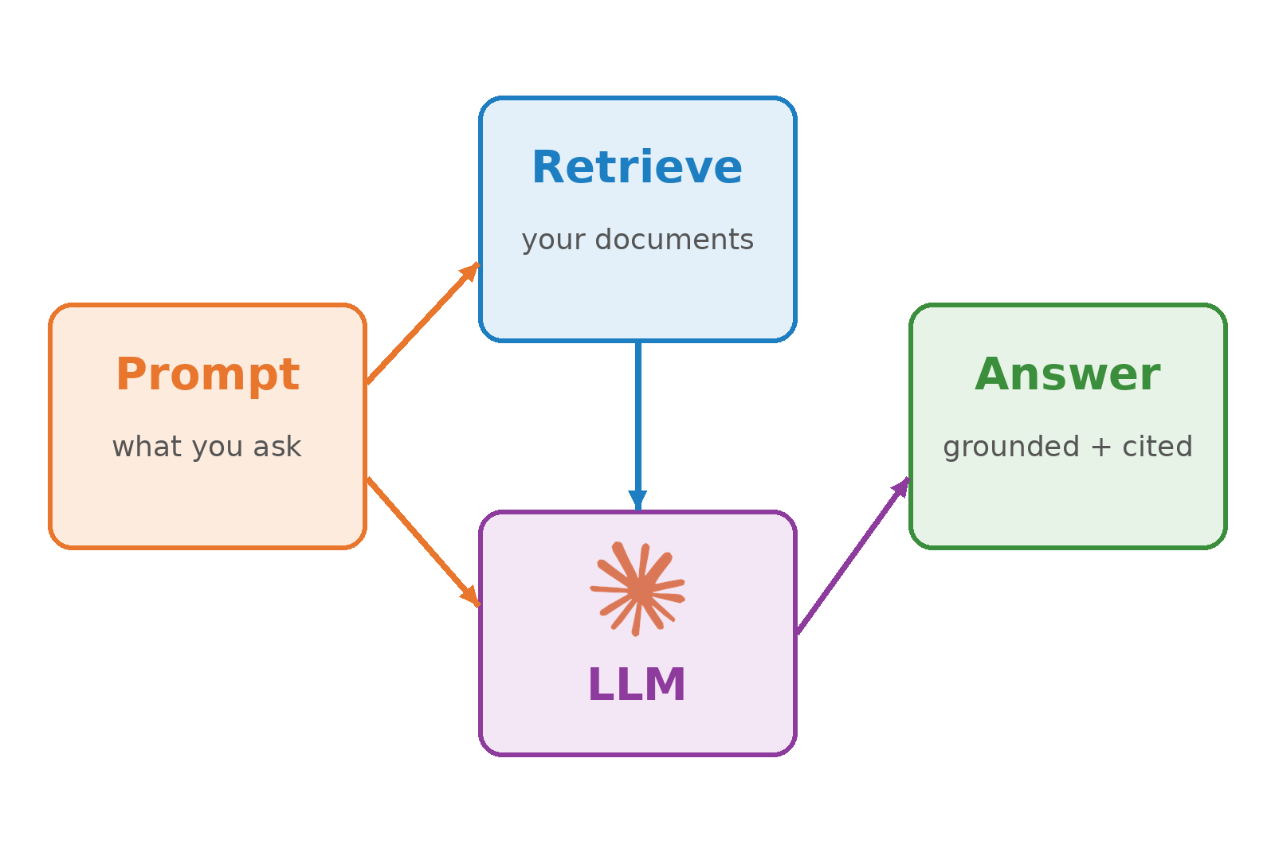
AML-3303 Prompt Engineering and Retrieval-Augmented Generation (RAG)

Slide 2
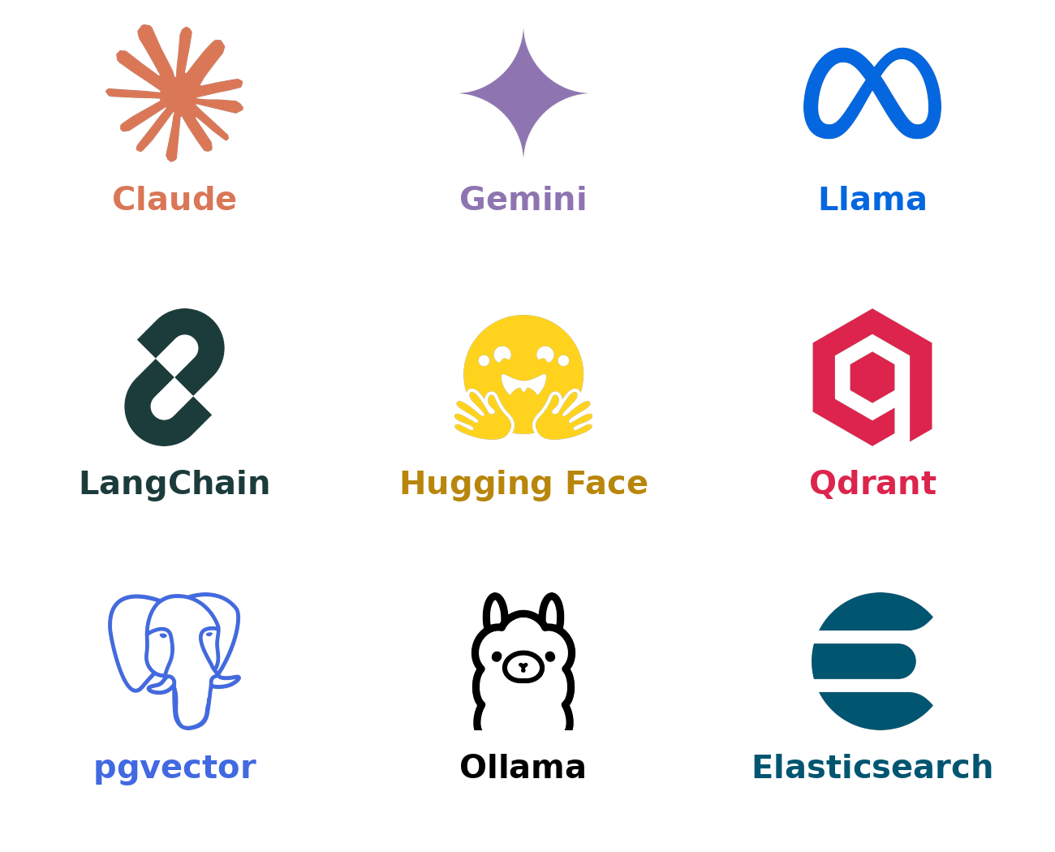
Topics We Will Cover
How LLMs generate text
Prompt engineering: anatomy, techniques, structured output
Why LLMs need RAG
The RAG pipeline: indexing, retrieval, generation
Chunking, prompts and evaluation
Advanced RAG and a hands-on build

Slide 3
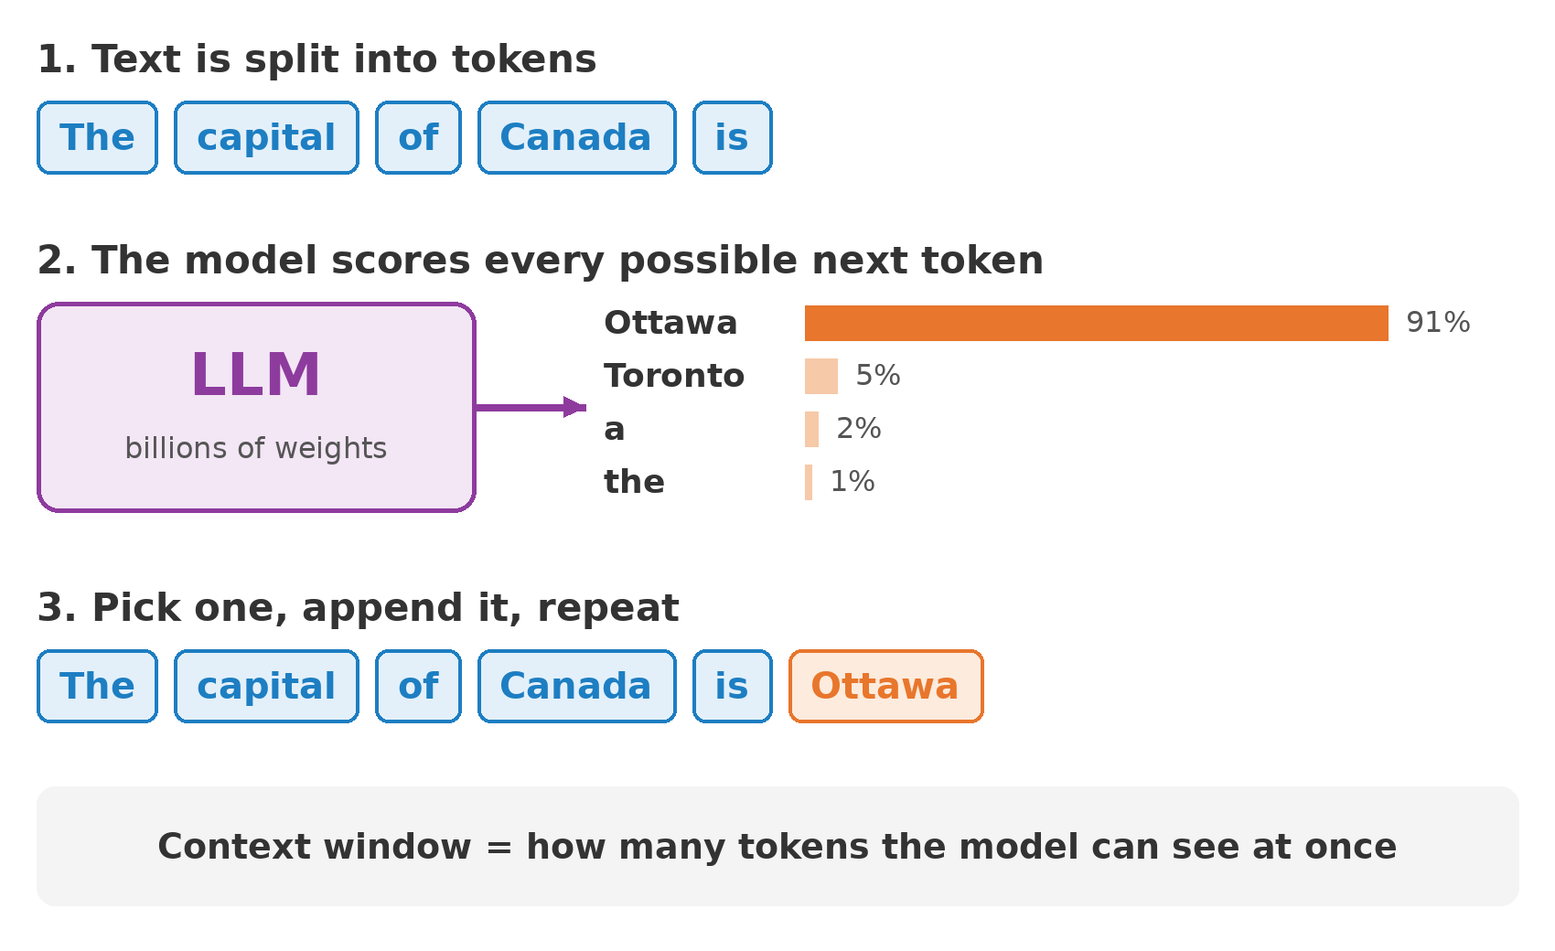
How an LLM Works
An LLM predicts the next token, one at a time.
Tokens: pieces of words, roughly 3/4 of a word each.
Probabilities: the model scores every possible next token.
Context window: everything it can see at once, prompt included.
No live lookup: it only knows its training data and your prompt.

Slide 4
What Is Prompt Engineering?
Designing the input so the model reliably produces the output you need.
It is specification, not magic words: clear task, context and format.
Cheapest lever you have: try a better prompt before a bigger model or fine-tuning.
Iterate: test on real examples, compare outputs, refine.

Slide 5
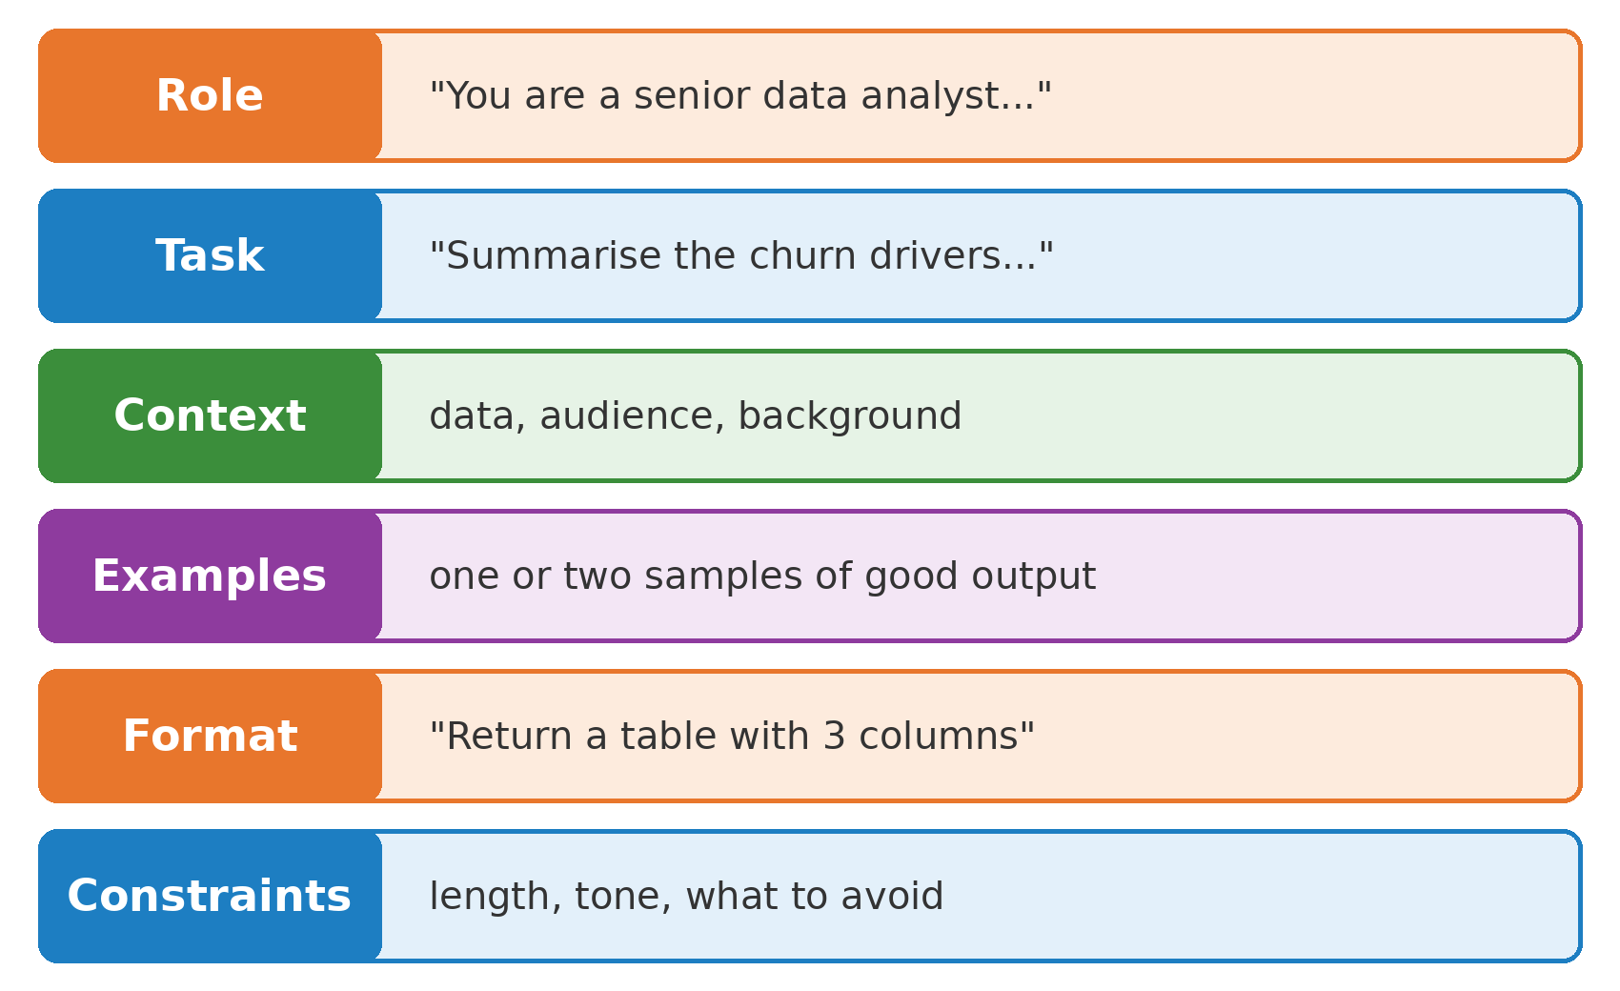
Anatomy of a Good Prompt
Strong prompts answer six questions for the model.
Role: who should it act as?
Task: what exactly should it do?
Context: what does it need to know?
Examples, format, constraints: what does good look like?

Slide 6
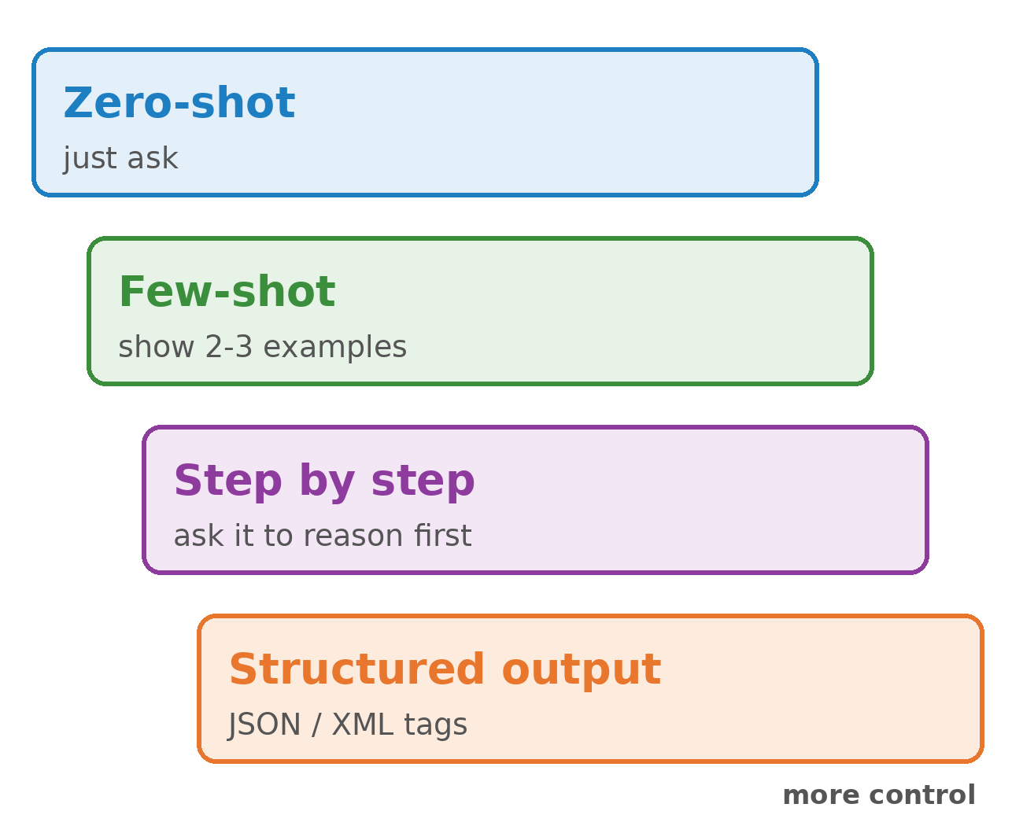
Prompting Techniques
Zero-shot: state the task directly.
Few-shot: show two or three input/output examples.
Step by step: ask the model to reason before answering.
Structured output: request JSON or wrap sections in XML tags.
Tip: put long documents first and the question last.

Slide 7
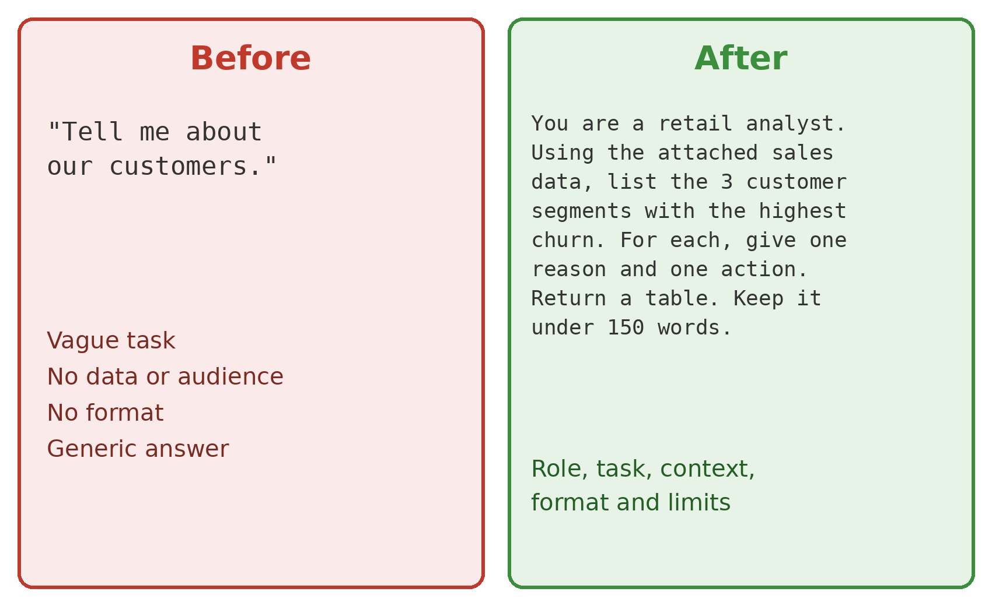
Before and After: Rewriting a Prompt
Same model, very different answer.
Before: vague task, no data, no format.
After: role, data, a concrete task, a table, a word limit.
Try it: run both against the same model and compare.

Slide 8
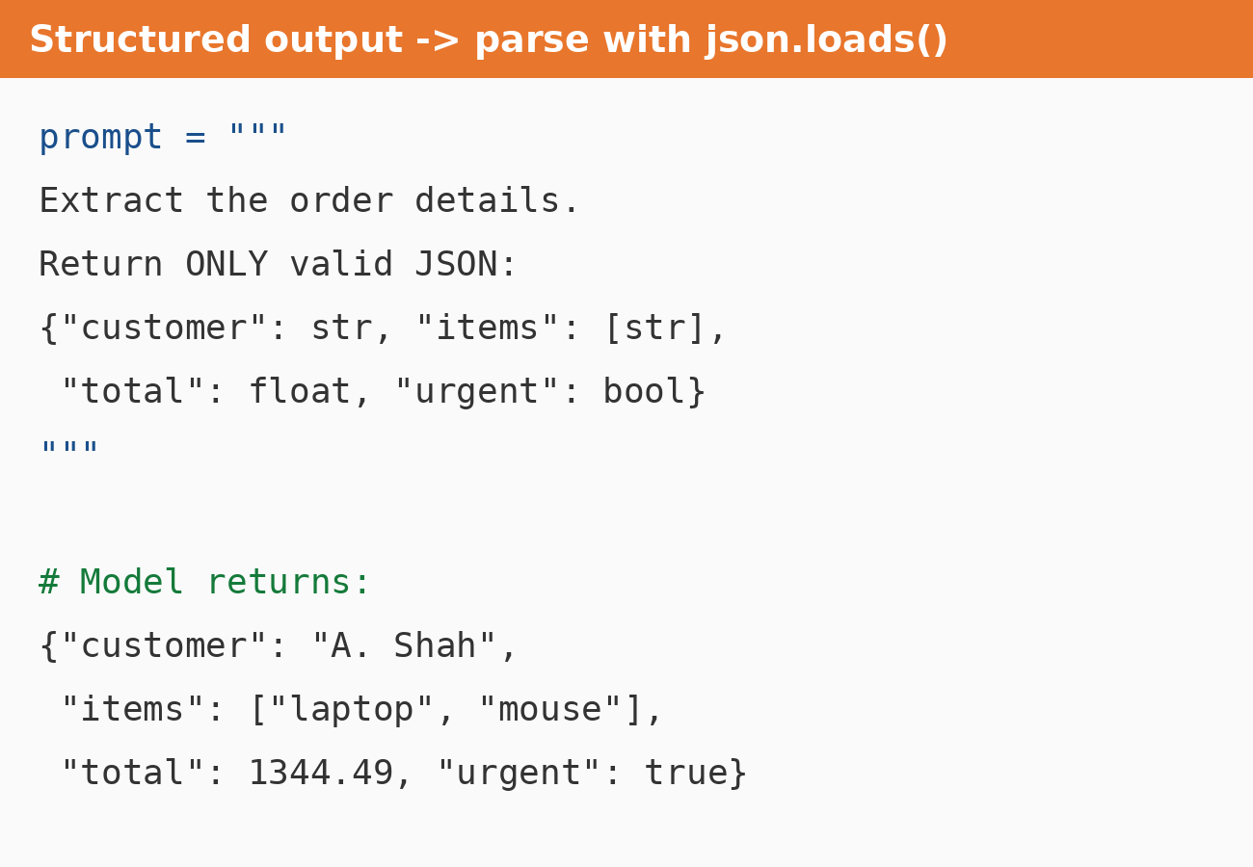
Structured Outputs
Ask for JSON when code will consume the answer.
Give the schema: field names and types.
Validate: parse with json.loads() or Pydantic and retry on failure.
Many APIs now enforce a schema directly.

Slide 9
Why LLMs Need RAG
Knowledge cutoff: the model does not know recent events.
No private data: it has never seen your policies, tickets or contracts.
Hallucination: without sources it fills gaps with plausible guesses.
RAG fixes all three by handing the model the right documents at question time.

Slide 10
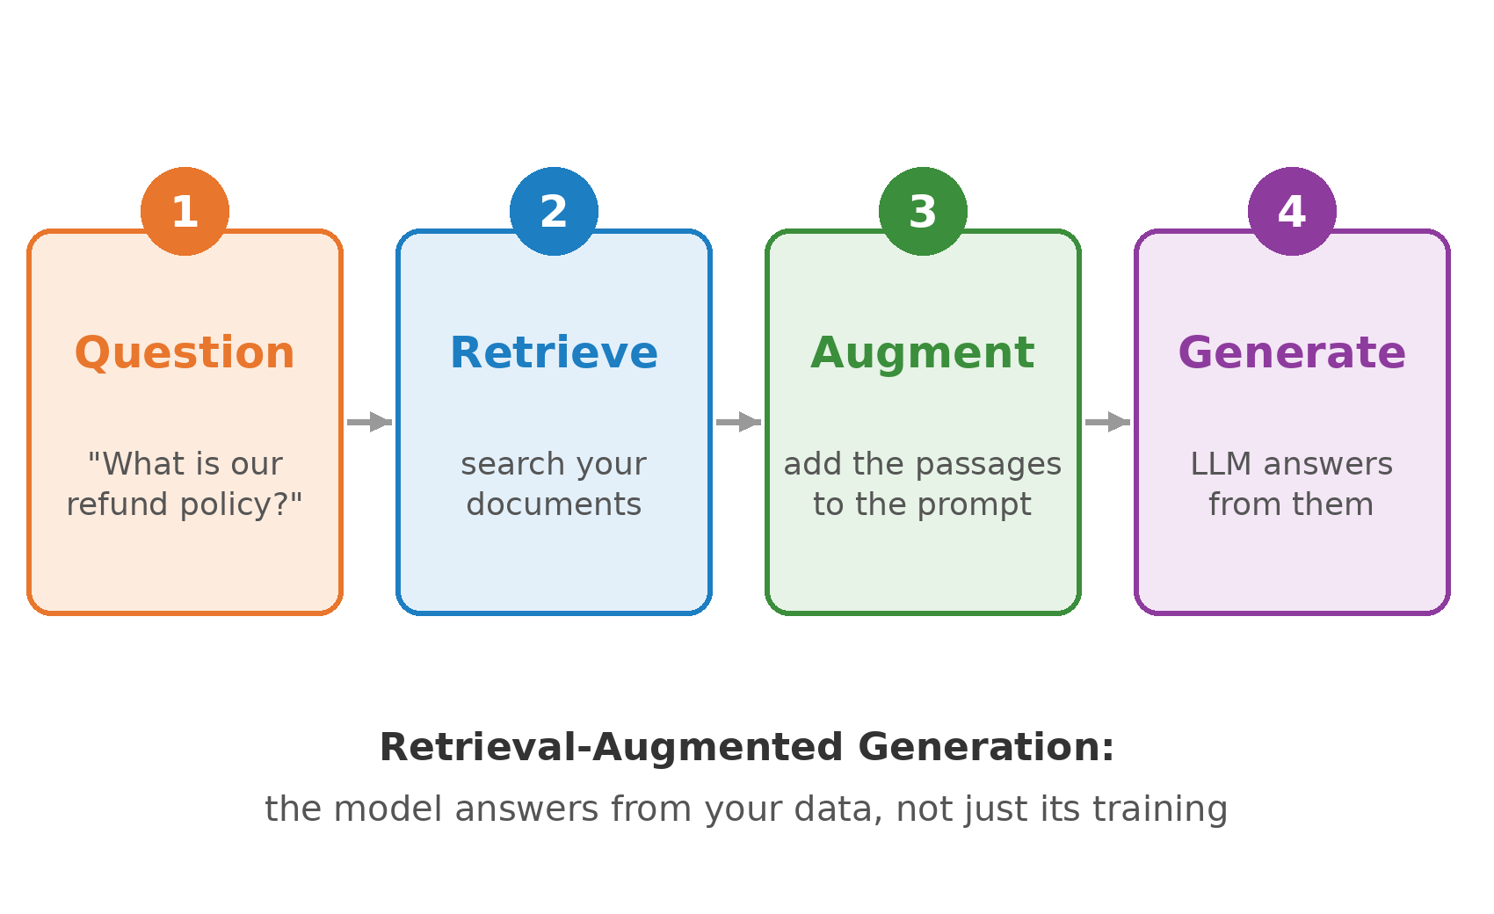
What Is RAG?
Retrieval-Augmented Generation grounds answers in your own documents.
Retrieve the passages most relevant to the question.
Augment the prompt with those passages.
Generate an answer that cites them.
No retraining: update the documents, not the model.

Slide 11
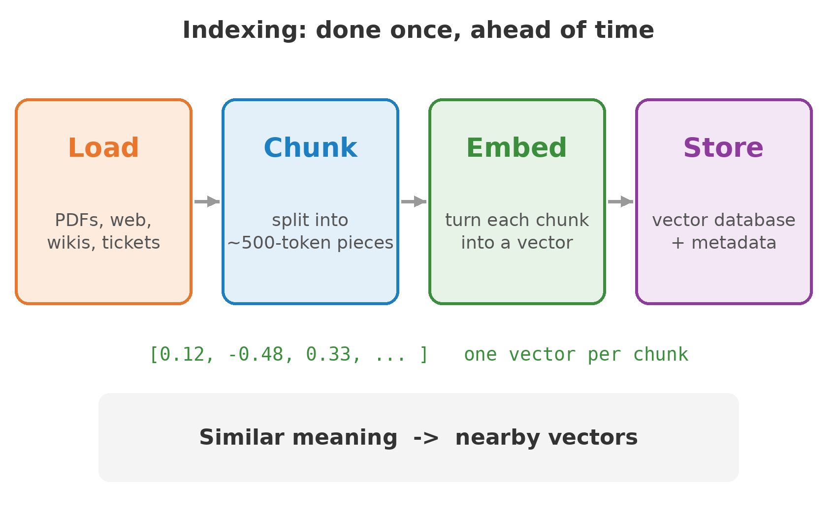
RAG Pipeline: Indexing
Prepare the knowledge base once, ahead of time.
Load: collect documents from their sources.
Chunk: split them into searchable pieces.
Embed: convert each chunk to a vector.
Store: save vectors and metadata in a vector database (Week 3).

Slide 12
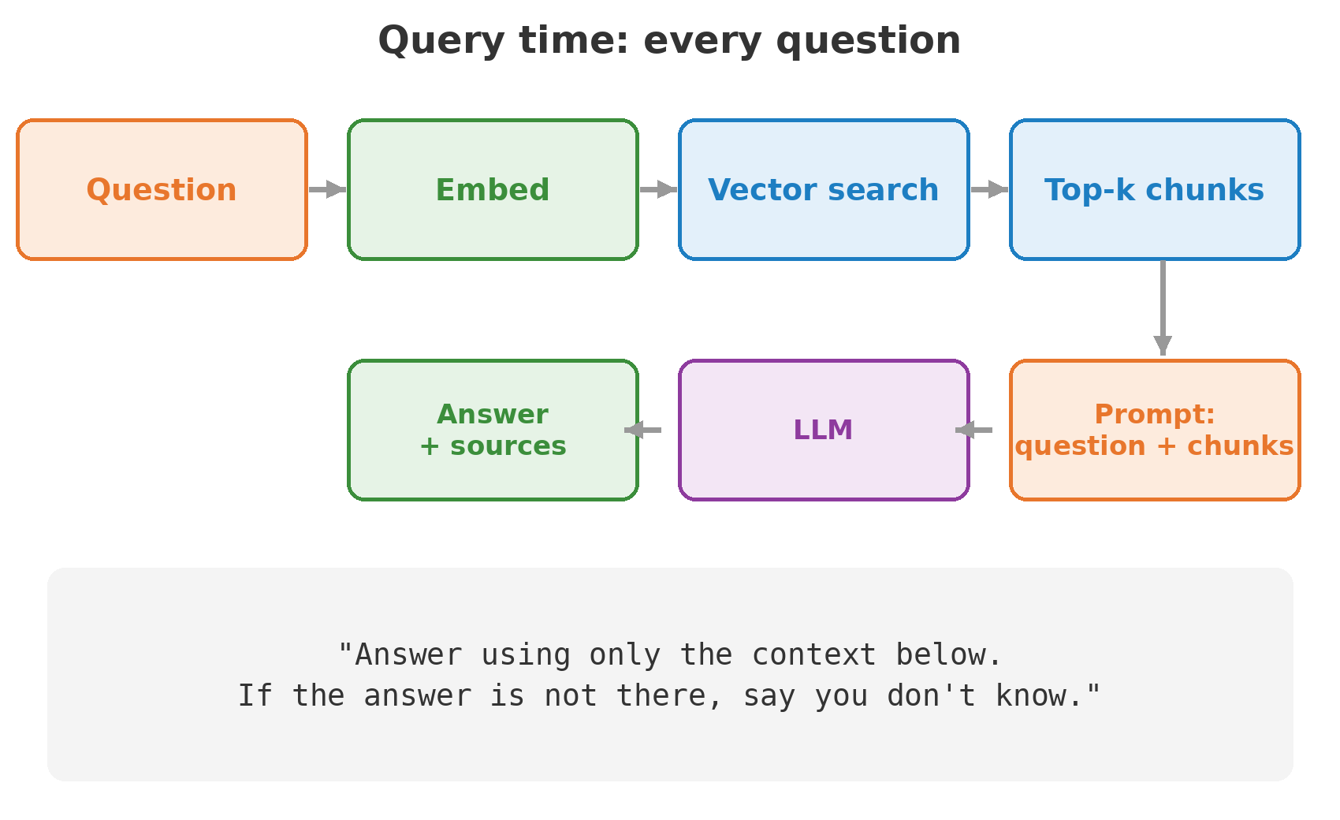
RAG Pipeline: Retrieval and Generation
Runs on every question.
Embed the question with the same model used for the chunks.
Search: find the top-k most similar chunks.
Prompt: combine question and chunks with clear instructions.
Answer: the LLM responds and cites its sources.

Slide 13
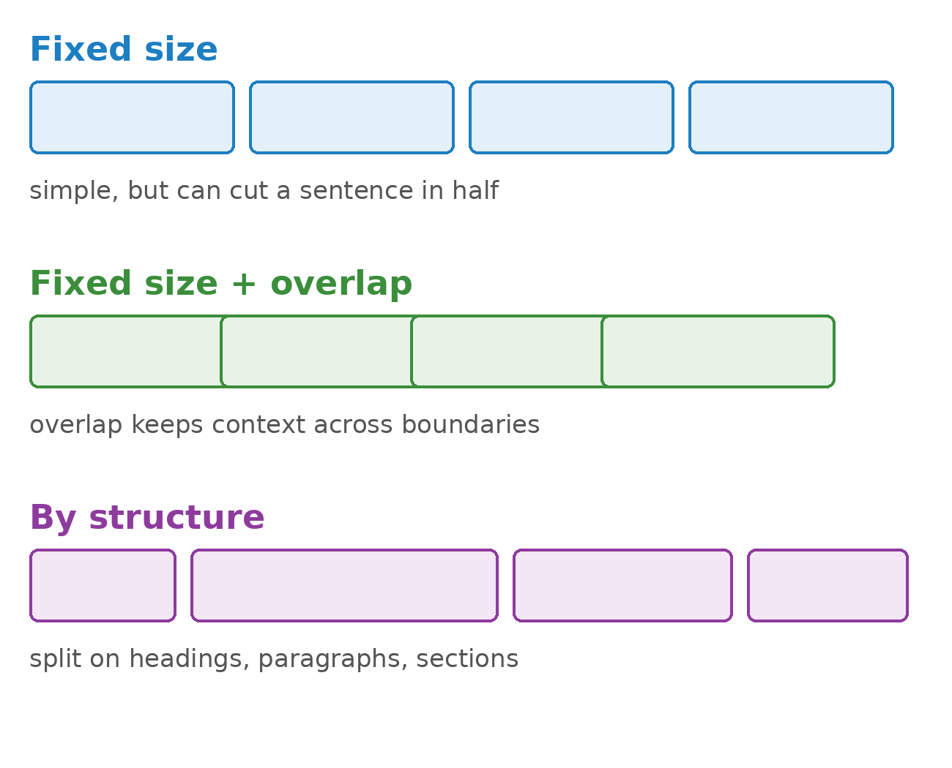
Chunking Strategies
Chunk size matters most: too big dilutes, too small loses context.
Start around 300 to 800 tokens with 10 to 20% overlap.
Respect structure: split on headings and paragraphs where you can.
Keep metadata: source, page, date for citations and filters.

Slide 14
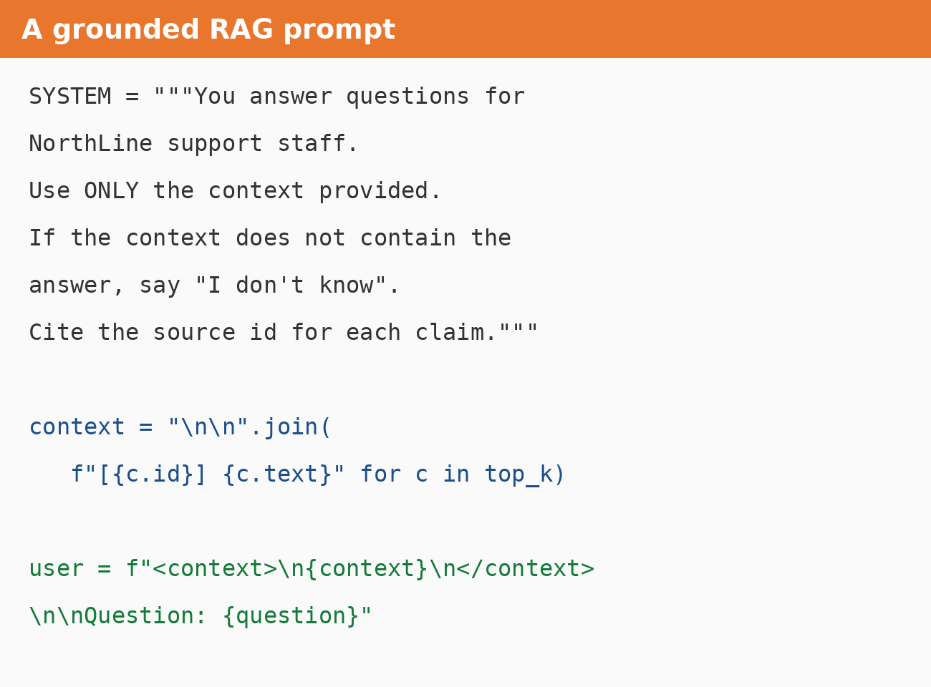
The RAG Prompt
Restrict the model to the provided context.
Give it a way out: "say you don't know".
Label each chunk with an id so answers can cite it.
Separate context and question with XML-style tags.

Slide 15
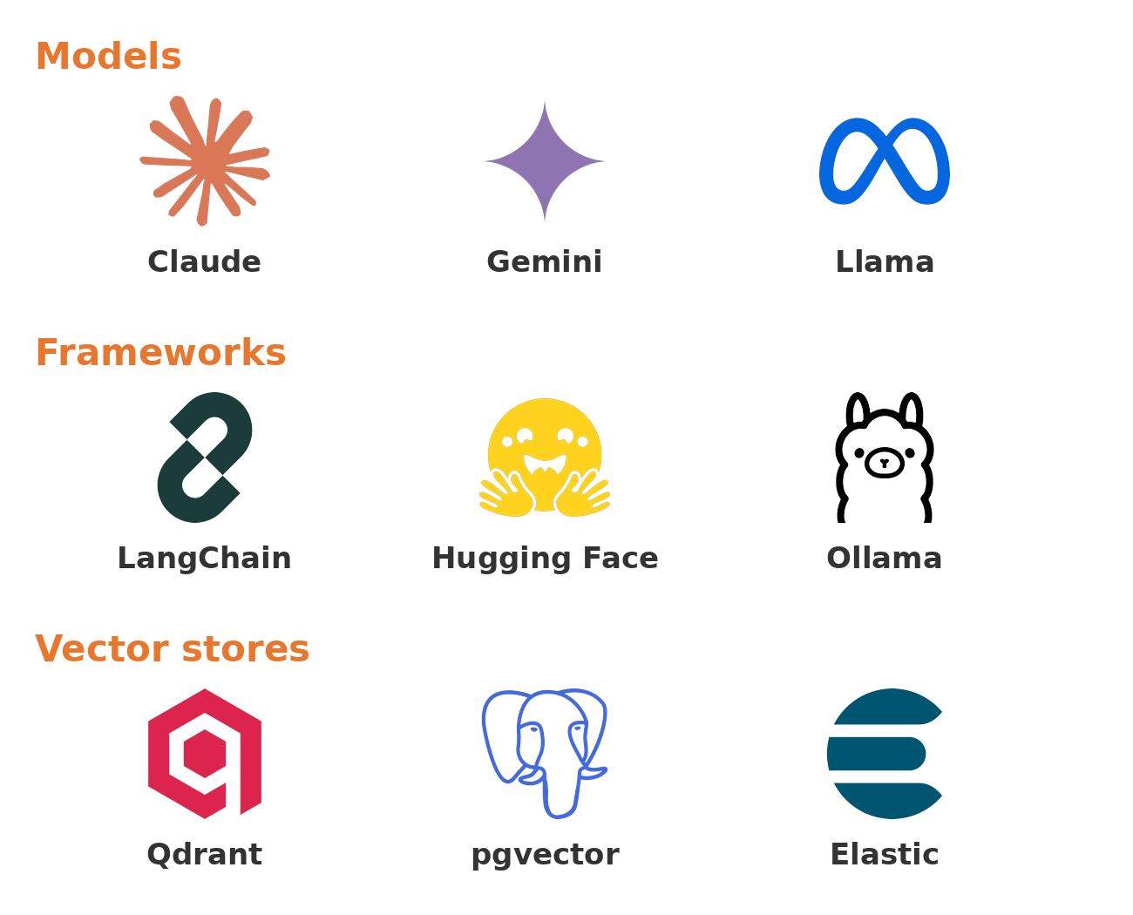
The RAG Tool Stack
Models: Claude, Gemini, Llama (local with Ollama).
Frameworks: LangChain, LlamaIndex, Hugging Face.
Vector stores: Qdrant, pgvector, Chroma, Pinecone, Elasticsearch.
Pick the simplest stack that meets the need.

Slide 16
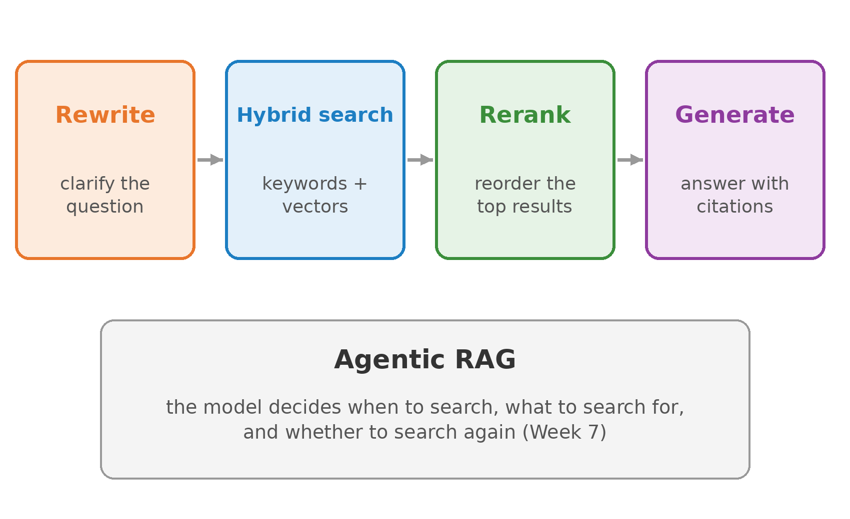
Advanced RAG
Techniques for when basic retrieval is not enough.
Query rewriting: rephrase vague questions before searching.
Hybrid search: combine keyword (BM25) and vector search.
Reranking: reorder the top results with a stronger model.
Agentic RAG: the model decides when and what to retrieve.

Slide 17
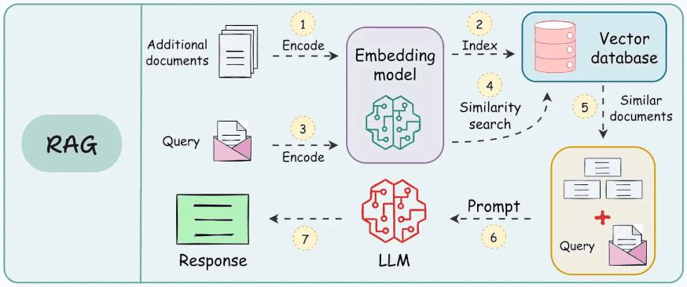

Slide 18
Key Takeaways
A clear prompt (role, task, context, format) is the cheapest way to better output.
RAG grounds answers in your own documents, without retraining the model.
Evaluate retrieval and generation separately: most failures start in retrieval.

